Slide 1
Database Experiment5-6

Slide 2
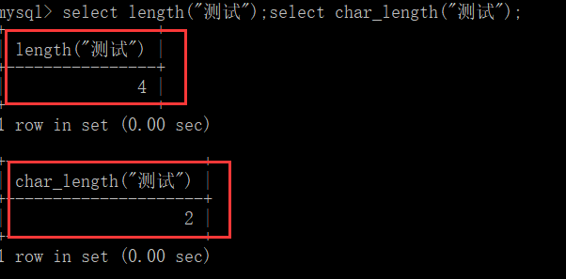
1. Exp-5 Stored Procedure
String processing funciton：
concat();
left();
right();
length(names):
char_length(names)
View stored procedure definition, status:
show create procedure jsearch1;
show procedure status like 'jsearch%';
数据库系统原理
Notes:
GaussDB@123

Slide 3
1. Exp 5- Trigger
Exception handling in MySQL：signal sqlstate
use student;
drop trigger if exists del_s;
delimiter $$
create trigger del_s before delete on s
for each row
begin
if OLD.sno in (select distinct(sno) from sc) then
signal sqlstate '03100'
set message_text = 'You cannot delete a student who has course selection records';
end if;
end$$
delimiter ;
sqlstate ：
='00' (success)
='01' (warning)
= '02' (not found)
> '02' (exception)
= '40'
引用：https://dev.mysql.com/doc/refman/8.0/en/signal.html
数据库系统原理
Notes:
GaussDB@123

Slide 4
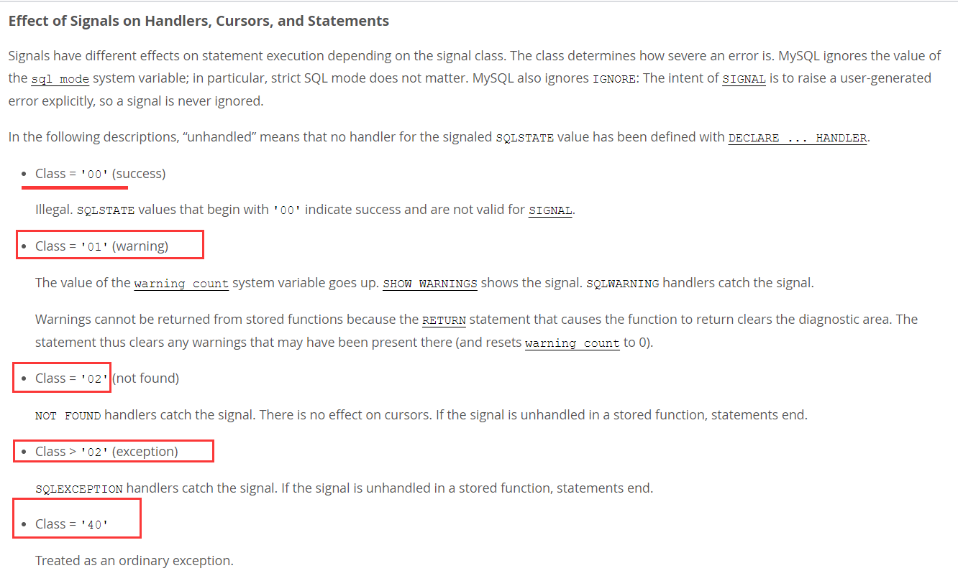
1. Exp 5 - Trigger
signal sqlstate '31000'： Error code description（00 indicates success， cannot be used with signal statements ）
数据库系统原理
Notes:
GaussDB@123

Slide 5
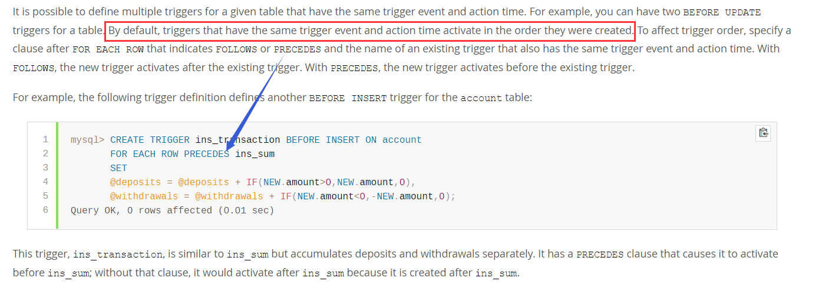
1. Exp 5- Trigger
Two triggers of the same type and event on the same table are permitted(eg., two before updates) , they can be triggered in the order of creation. Keywords (precedes / follow) can be used to specify trigger order explicitly.
https://dev.mysql.com/doc/refman/8.0/en/trigger-syntax.html
数据库系统原理
Notes:
GaussDB@123

Slide 6
1. Exp 5- Trigger
Delete trigger：
DROP TRIGGER database.trigger_name (mysql)
DROP TRIGGER trigger_name (mysql)
DROP TRIGGER trigger_name ON tablename (Most other DBMS)
数据库系统原理
Notes:
GaussDB@123

Slide 7
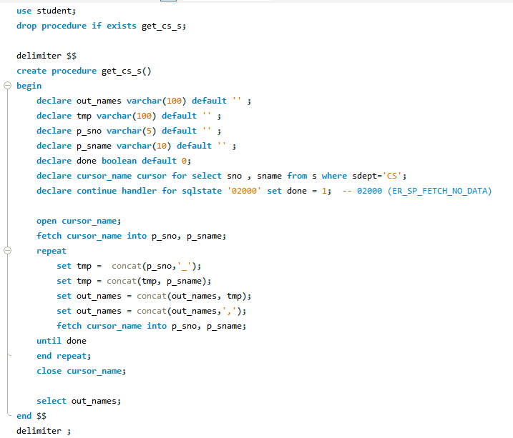
1. Exp 5- Trigger
数据库系统原理
Notes:
GaussDB@123

Slide 8
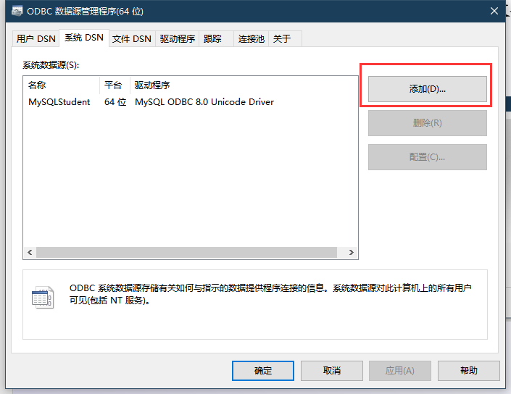
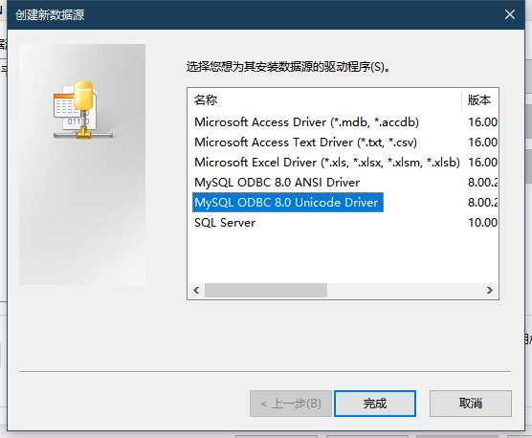
2. Exp 6- ODBC
ODBC data source configuration
Manual configuration：control panel -〉Manage tools -> data source(ODBC) （Install the ODBC driver for MySQL in advance.）
数据库系统原理
Notes:
GaussDB@123

Slide 9
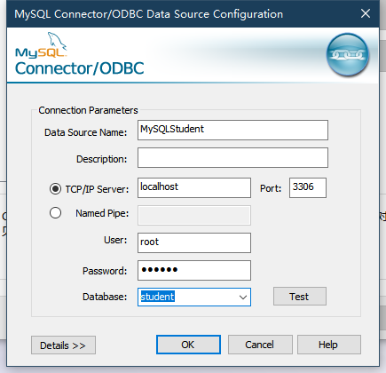
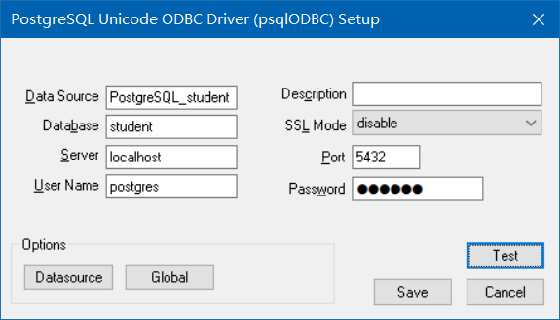
2. Exp 6- ODBC
ODBC data source configuration
Manual configuration：control panel -〉Manage tools -> data source(ODBC) （Install the ODBC driver for MySQL in advance.）
数据库系统原理
Notes:
GaussDB@123

Slide 10
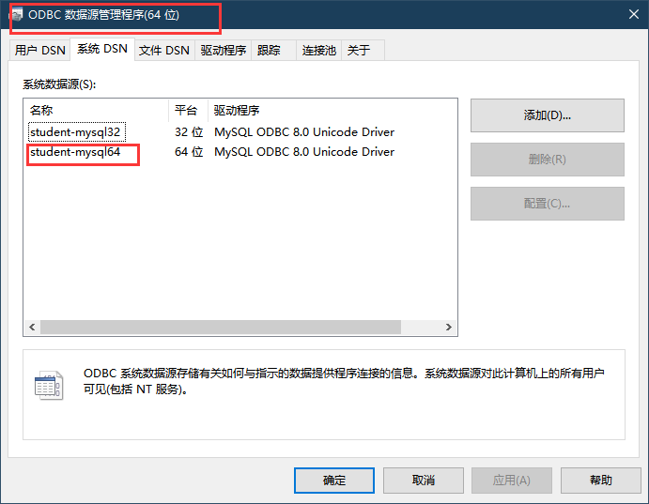
2. Exp 6 - ODBC
ODBC data source configuration
Manual configuration：control panel -〉Manage tools -> data source(ODBC) （Install the ODBC driver for MySQL in advance.）
数据库系统原理
Notes:
GaussDB@123

Slide 11
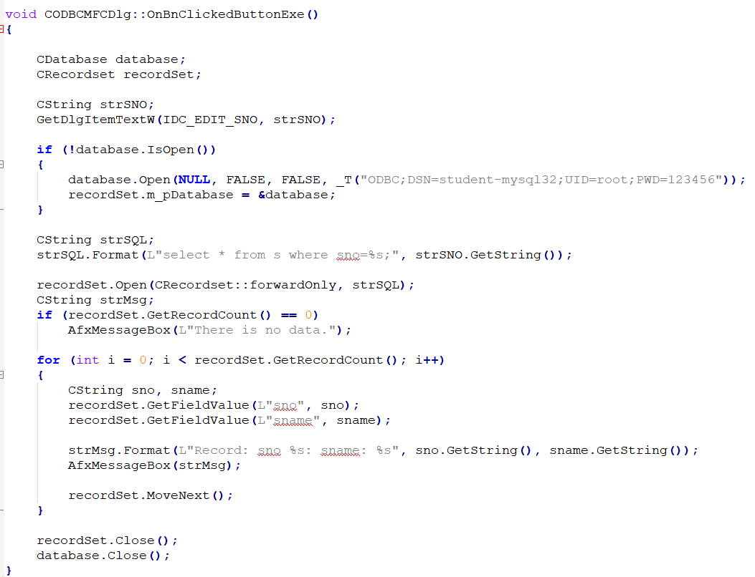
2. Exp 6 - ODBC
ODBC program example（C++）
数据库系统原理
Notes:
GaussDB@123

Slide 12
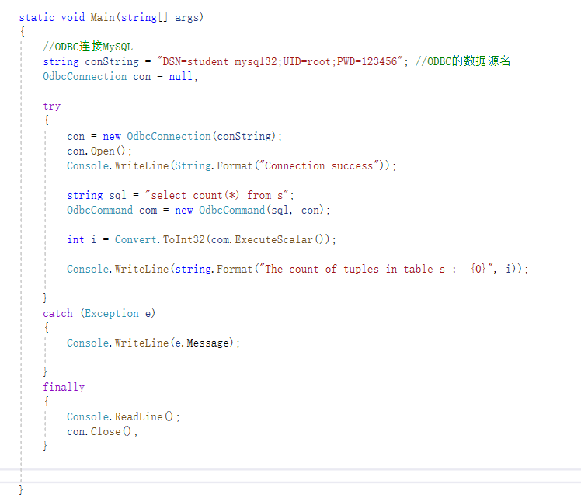
2. Exp 6 - ODBC
ODBC program example（C#）
数据库系统原理
Notes:
GaussDB@123

Slide 13
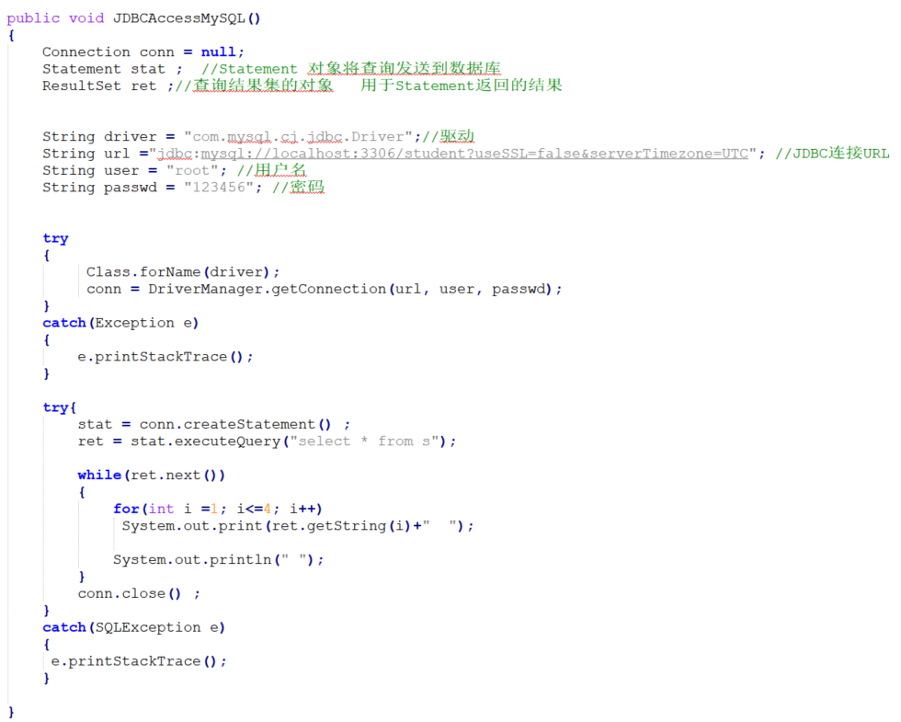
2. Exp 6 - JDBC
JDBC program example（JAVA）
数据库系统原理
Notes:
GaussDB@123

Slide 14
2. Exp 6 - Comprehensive application experiment of bank finance
(1) According to the requirements, write SQL statements of different scenarios for the bank database.
(2) Referring to the programming examples of JDBC / ODBC / third-party library, use one of the ways to access the bank database from the application program, and execute the SQL statement of question (1).
数据库系统原理
Notes:
GaussDB@123

Slide 15
2. Exp 6 - Comprehensive application experiment of bank finance
Step 1:The bank sales new financial product.
Step 2:Customers purchase No. 4 products (purchase and deduct money from corresponding bank card).
Step 3: The bank cashes the income.(compute income and update balance)
Step 4: The bank stops the financial product No.4
数据库系统原理
Notes:
GaussDB@123

